Slide 1

Intel Image Classification (CNN - Keras) IDS 594- Machine Learning with Python
Gnana Teja Peddi

Slide 2

Intel Image Classification: Agenda
Dataset Description
Data Distribution
Project Overview
Why CNN?
Tools and Techniques
Data Upload in COLAB
Data Modeling
Hyperparameter Tuning
Model Accuracy
Limitations
Questions?

Slide 3
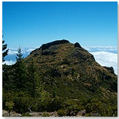
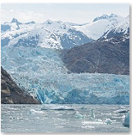
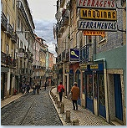
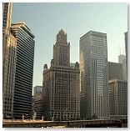
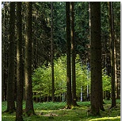
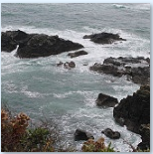
Dataset Description
Around 25,000 Images of size 150 * 150
Train Test Prediction
14033 3000 7300
Types Of Images
Mountain Glacier Street
Buildings Forest Sea

Slide 4
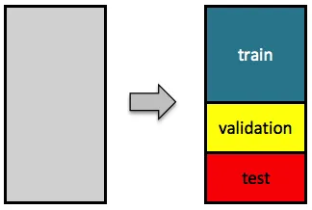
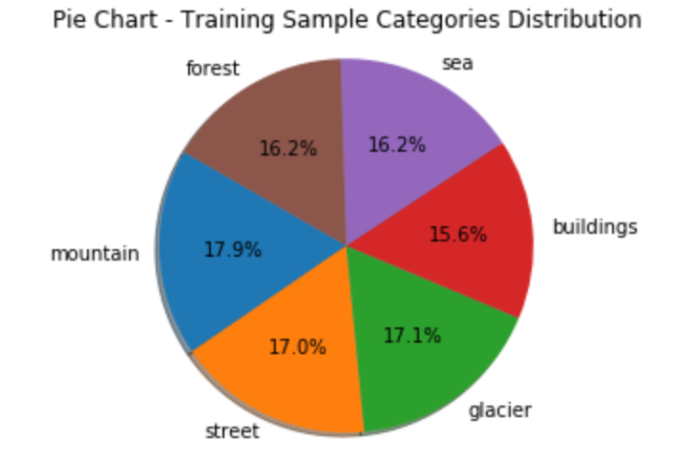
Data Distribution
Full Data | Train Images | Validation Images | Test Images
Buildings | 1560 | 638 | 437
Forest | 1629 | 642 | 474
Glacier | 1666 | 738 | 553
Mountain | 1732 | 780 | 525
Sea | 1586 | 688 | 510
Street | 1657 | 725 | 501
Notes:
Loaded data into shared drive > Mounting Data >

Slide 5
Project Overview
Image Classification
Project Scope
Object Recognition
Human vs. Machine
Categorization
Deep Learning Library Keras
TensorFlow backend
Custom build CNN

Slide 6

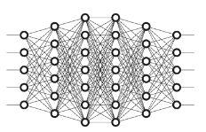

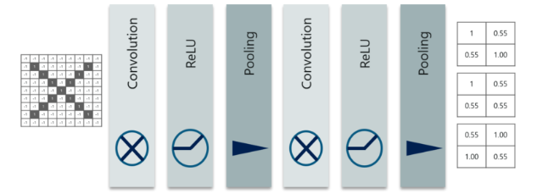
Why CNN?
Fully Connected Networks
25 * 25 * 3
1,875 Weights in first Hidden Layer
200 * 200 * 3
120,000 Weights in first Hidden Layer
Convolutional Neural Networks

Slide 7

Data Preparation - Tools and Techniques used
Initial Exploration – Jupyter
Google COLAB
GPU capability
Robust sharing features
Prepare the image data for ingestion into the planned Convolutional Neural Network
Separate directories for all six classes
CNN: Computation Intensive Models
Notes:
Loaded data into shared drive > Mounting Data >

Slide 8

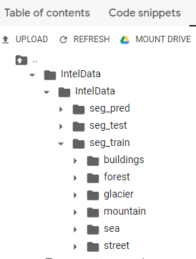
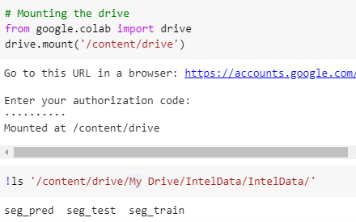
Data Upload in COLAB
Mounting the Drive

Slide 9
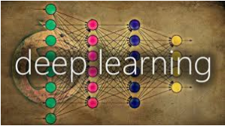
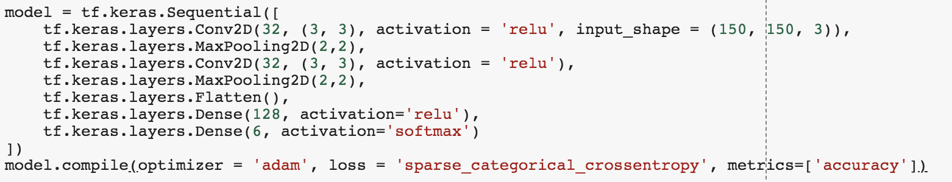
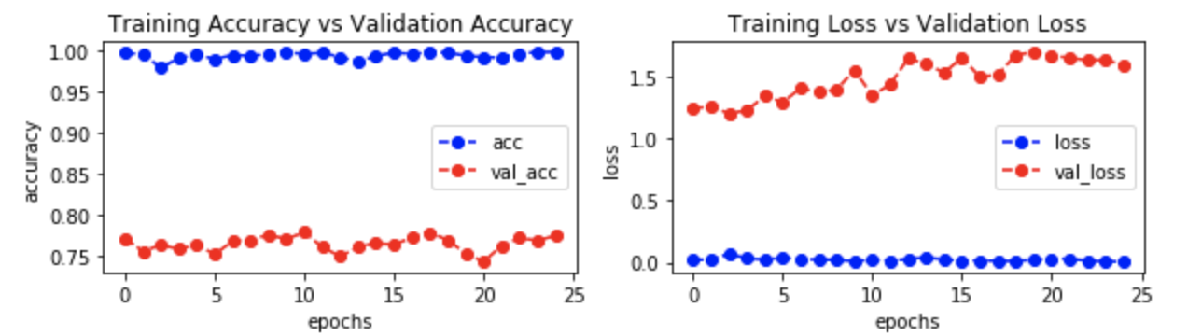
Data Modeling
Initial- Simple Model

Slide 10
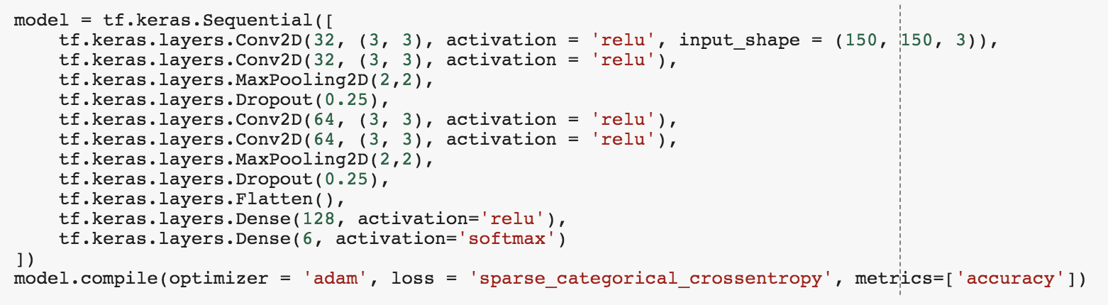
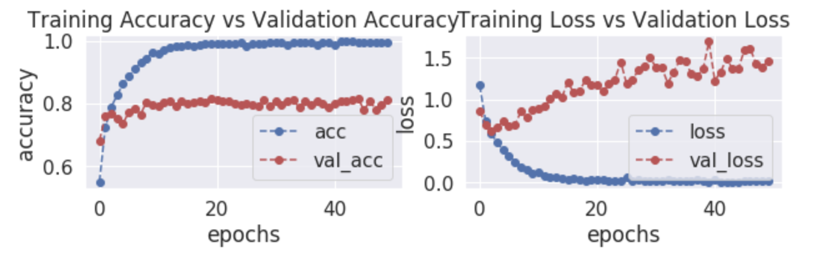
Hyperparameter Tuning
Model 2

Slide 11
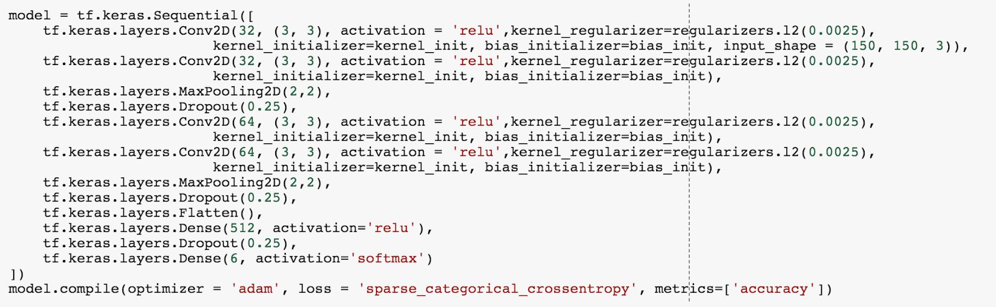
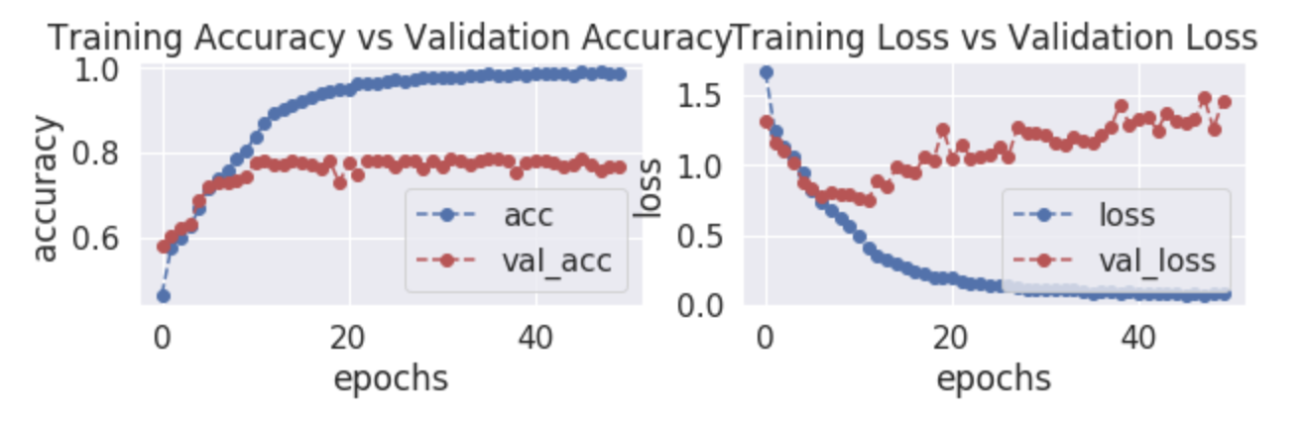
Hyperparameter Tuning (contd.)
Model 3

Slide 12
Transfer Learning
Transfer learning is a technique where you use a model trained on a very large dataset and then adapt it to your own dataset. We will be using FastAi library which is a high-level library build on PyTorch, which allows us to build models.
Base model
We will be using pretrained Resnet50 model and tune it using few techniques:
1) Cyclical learning rate
2) Mixup augmentation
3) Sane weight initialization
4) ImageCleaner

Slide 13
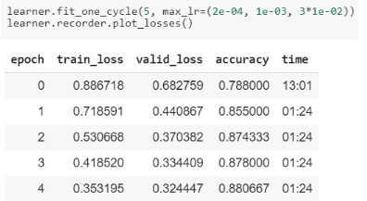
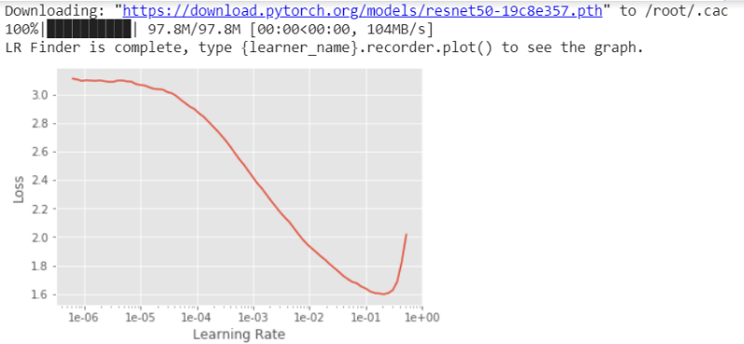
Transfer Learning: Cyclical learning rate
we run a trial with a lower learning rate & increase it exponentially, recording the loss along the way. We then plot the loss against learning rate & choose the learning rate where the loss is the steepest.
model4
In the base model we see that we have reached accuracy of 88% in just 5 epochs.

Slide 14
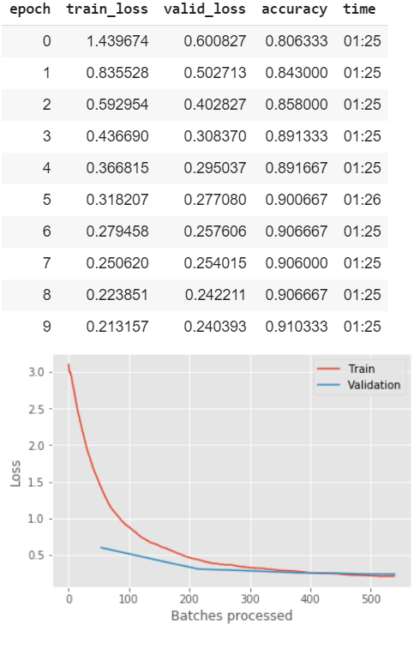
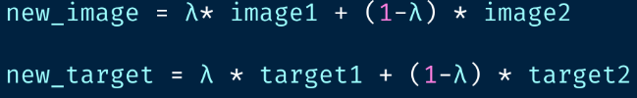
Transfer Learning: Cyclical learning rate
To increase our accuracy we are performing a type of augmentation where in we form a new image through weighted linear interpolation of two existing images.
model4
In the updated model we see that we have reached accuracy of 91.6% in 10 epochs.

Slide 15
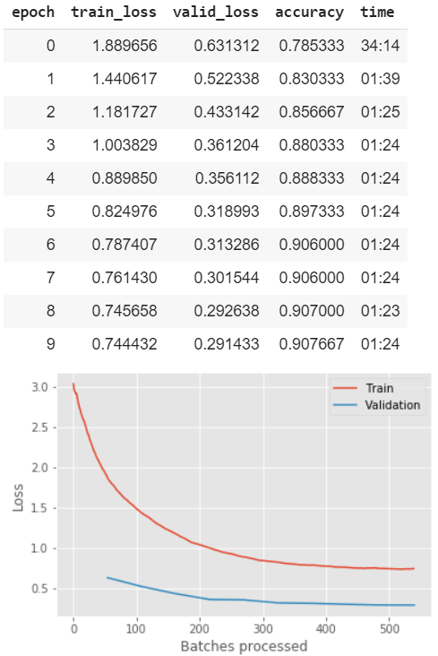
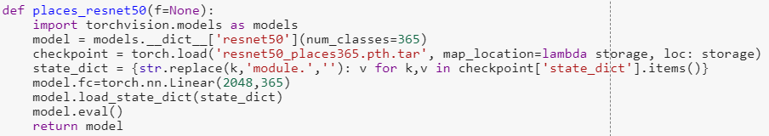
Transfer Learning: Sane weight initialization
Dataset provided in the challenge was very similar to this dataset, so the model trained on this dataset will already have learned features that are relevant to our own classification problem. As, the categories in our problem, was a subset of Places365 dataset, we used a ResNet50 model initialized with places365 weights.
model4
In the updated model we see that our model is underfitting for train data. But accuracy is same.

Slide 16
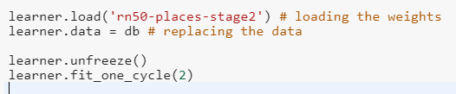
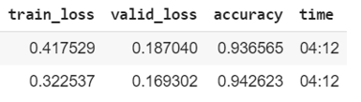
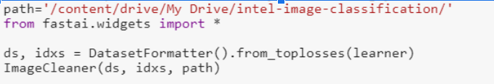
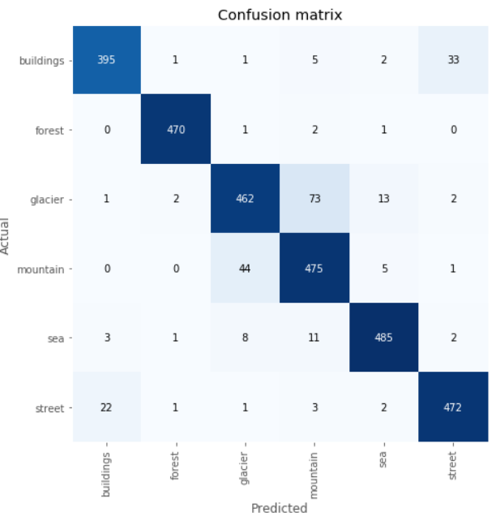
Transfer Learning: ImageCleaner
FastAI also provides functionality for cleaning your data using Jupyter widgets. The ImageCleaner class displays images for relabeling or deletion
model4
It gives us the option to relabel/delete from our top miss predictions and the new labels are stored in a csv, which is then used to refine training data.

Slide 17
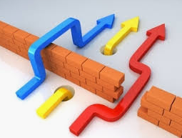
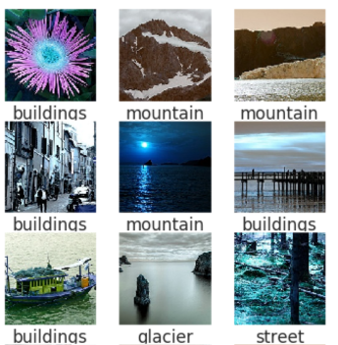
Limitations
Limitations
Mislabeled Images
Trust the solution: Don’t try to over-fit to get every image correct

